Slide 1

Basic Introduction
Notes:
Types of Documents: NDA Required (NDA)
Audiences:
AMI employees
AMI customers under NDA
May be posted to password-protected websites for customers
example: AMI Portal
Cannot be distributed as a public document
Examples:
Porting guides
Product roadmaps & technical overviews
Customer training

Slide 2

Legal
Disclaimer
This publication contains proprietary information which is protected by copyright. No part of this publication may be reproduced, transcribed, stored in a retrieval system, translated into any language or computer language, or transmitted in any form whatsoever without the prior written consent of the publisher, American Megatrends, Inc. American Megatrends, Inc. retains the right to update, change, modify this publication at any time, without notice.
For Additional Information
Call American Megatrends, Inc. at 1-800-828-9264 for additional information.
Limitations of Liability
In no event shall American Megatrends be held liable for any loss, expenses, or damages of any kind whatsoever, whether direct, indirect, incidental, or consequential, arising from the design or use of this product or the support materials provided with the product.
Limited Warranty
No warranties are made, either express or implied, with regard to the contents of this work, its merchantability, or fitness for a particular use. American Megatrends assumes no responsibility for errors and omissions or for the uses made of the material contained herein or reader decisions based on such use.
Trademark and Copyright Acknowledgements
Copyright © 2014 American Megatrends, Inc. All rights reserved.
American Megatrends, Inc., 5555 Oakbrook Parkway, Suite 200, Norcross, GA 30093, USA.
All products names used in this publication are for identification purposes only and are trademarks of their respective companies.

Slide 3
PEI Overview

Slide 4
PEI Phase – Why?
PEI = Pre-EFI Initialization
Why PEI Phase?
Code is not compressed
Memory is not initialized
Chipset is not initialized
Points of PEI Phase
Code is executed on ROM
Code is not compressed
PEI Core code is not related to platform

Slide 5
PEI – Do what?
Basic initialization for Chipset
Memory Sizing
BIOS Recovery
ACPI S3 Resume
Switch Stack to Memory
Disable CAR
Enable Cache
Invoke DxeIpl (DXE Initial Program Loader)

Slide 6
PEI – CORE, SERVICE, PEIM, PPI
PEI Core
Provide service for PEIM
Load and Execute PEIM
PEI Service
PEI Core service routine , all PEIMs can use them
PEIM
PEI Module
PPI
PEI to PEI Interface，PEIM provides interface to others

Slide 7
PEI – Flow Chart
Initialize PEI Core
Execute PEIM based on dependency status
Different Boot Mode are likely using different boot path
Execute DXE IPLPEI
PEI Start
PEI Core dispatch
initialization
PEIM n
PEIM 3
Pass 1 EntryPoint
PEIM 2
Pass 1 EntryPoint
Dispatch PEIM in
PEIM 1
Pass 1 EntryPoint
an orderly manner
Pass 2 EntryPoint
Entry Point
Pass 2 EntryPoint
Pass 2 EntryPoint
DXE IPL PEIM
PEI Core
Entry Point
dispatches DXE
IPL
DXEIPL PPI
Load/Start DXE

Slide 8
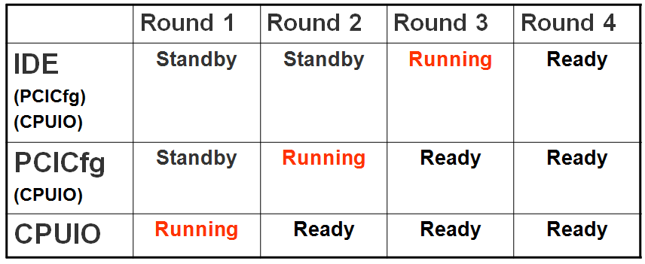
PEI - Dependency
PEIMs Order
Dependency for PEIM priority
Without Dependency, the order is in ROM image

Slide 9
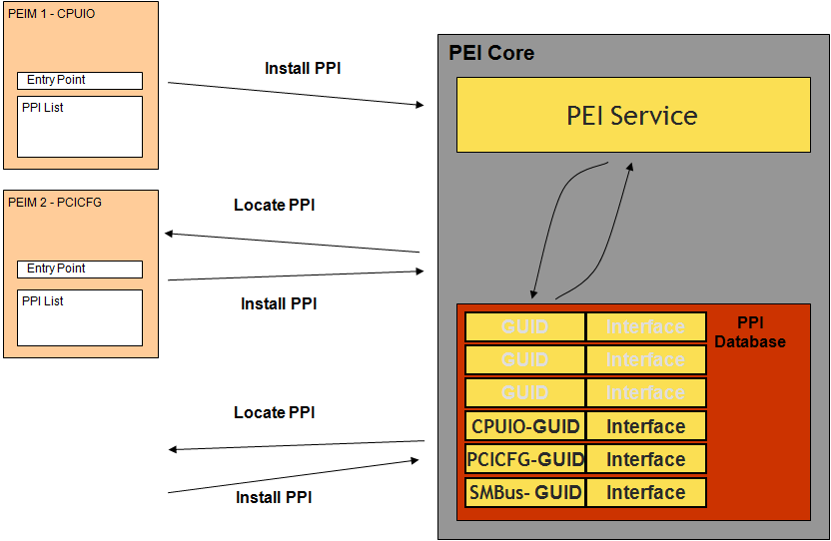
PEIM & PPI Working Model

Slide 10
PEI – HOB
HOB : Hand off Block
Why?
PEI Phase pass some information to DXE Phase
Data Structure
Every Block has its own GUID & Structure

Slide 11
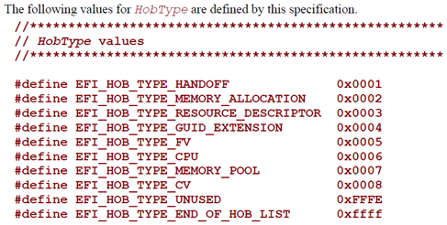
PEI – HOB
Operational Module
When PEI Module needs to pass information to DXE phase, It will call PEI Service to create a block of HOB in HOBList
Type
Hand Off (PHIT)
Memory Allocation
Resource Descriptor
GUID extension
FV
CPU
Memory Pool
CV (Capsule Volume)
Unused

Slide 12
PEI – Summary
PEI Phase the shorter the better
Goal
Essential Initialize for Hardware
Memory Sizing
S3 Resume
Recovery
DXEIPL the last invoked PEI Module
DXEIPL pass information to DXE by HOB List

Slide 13
Thank you!
*Information is subject to change without notice.

